Slide 1
NODE.JS
(The Backend Of MERN Stack)
Lecture 32

Slide 2
Today’s Agenda
MongoDB Cursor
Benefits Of Cursor
How To Receive A Cursor ?
Important Methods Of Cursor
Exercises

Slide 3
what is a cursor ?
A MongoDB collection can store millions of documents(records)
To fetch these documents from a collection we call the method collection.find().

Slide 4
what is a cursor ?
But the find() method does not immediately return all values matching the query.
This is because a query can potentially match very large sets of documents.
So find() returns a pointer to the collection of documents and this pointer is called cursor.

Slide 5
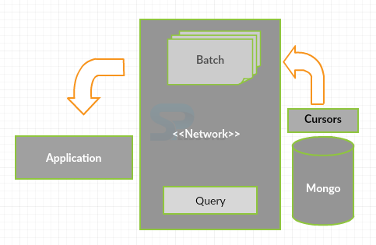
what is a cursor ?

Slide 6
benefits
A cursor can fetch the documents in batches to reduce memory consumption and network bandwidth.
It also allows us to retrieve and manipulate data in a controlled and efficient manner.

Slide 7
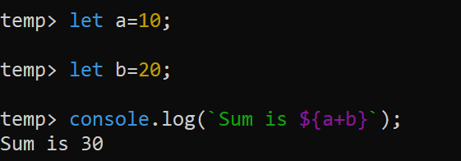
How to receive a cursor ?
We know that the Mongo Shell is an interactive JavaScript interface to MongoDB.
It means we can execute JS statements in Mongo Shell.

Slide 8

How to receive a cursor ?
Similarly we can create a JS variable to receive the cursor object returned by the find() method.
In the above code empDocs will be our cursor object reference and using it we can call various methods of the cursor.

Slide 9
Important methods of cursor
hasNext():
Description: Checks if there are more documents in the cursor.
Returns: Boolean (A true value if there are more documents, and false otherwise).
next():
Description: Returns the next document in the cursor.
Returns: Document (the next document in the cursor).

Slide 10
Important methods of cursor
forEach():
Description: Applies a function to each document in the cursor.
Parameters:
Callback function: A function to be executed for each document in the cursor.
Returns: None

Slide 11
Important methods of cursor
count():
Description: Returns the number of documents in the cursor without fetching them.
Returns: Integer
limit():
Description: Limits the number of documents returned by the cursor.
Parameters:
Integer: Indicating maximum documents to be returned
Returns: Cursor (a new cursor with the specified limit)

Slide 12
Important methods of cursor
size():
Description: Returns the number of documents in the cursor by fetching them.
Returns: Integer
sort():
Description: Sorts the documents in the cursor based on the specified field(s) and order.
Parameters:
Sort Fields: Document (fields to sort by, with the order as 1 for ascending and -1 for descending).
Returns: Cursor (a new cursor with the specified sorting)

Slide 13
Important methods of cursor
toArray():
Description: Converts the cursor into an array of documents.
Returns: Array
close():
Description: Closes the cursor, releasing resources on the server.
Returns: Nothing

Slide 14
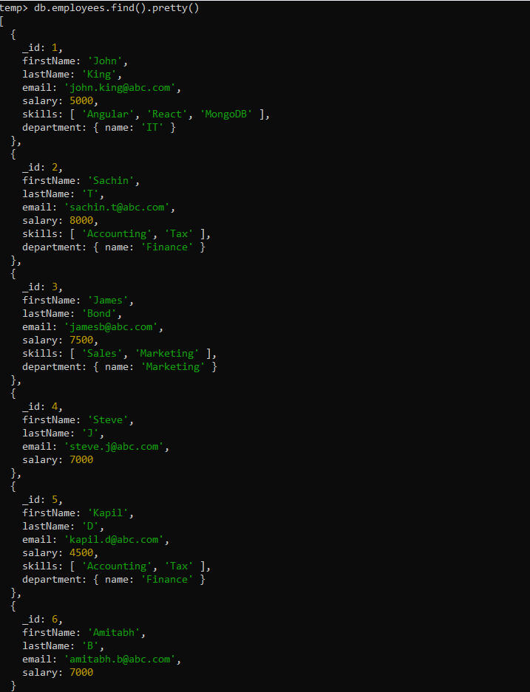
Sample database

Slide 15
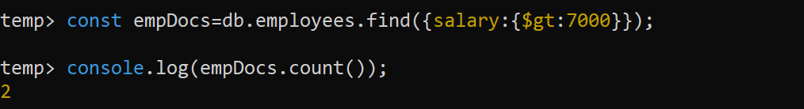
Exercise 15
Display total number of employees who earn more than 7000.

Slide 16
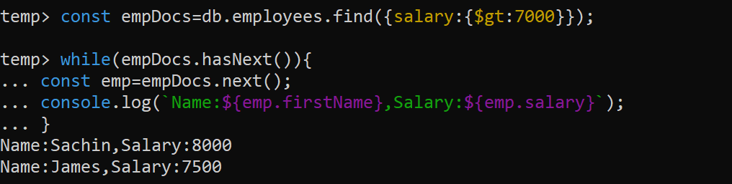
Exercise 16
Display names all the employees along with their salary who earn more than 7000

Slide 17
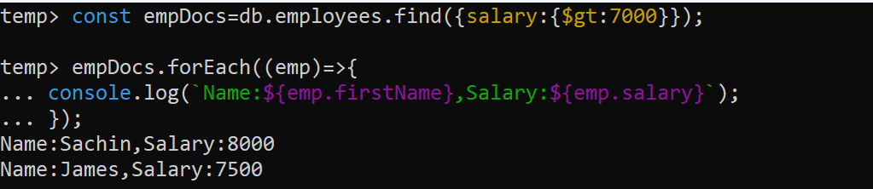
Alternate solution 1

Slide 18
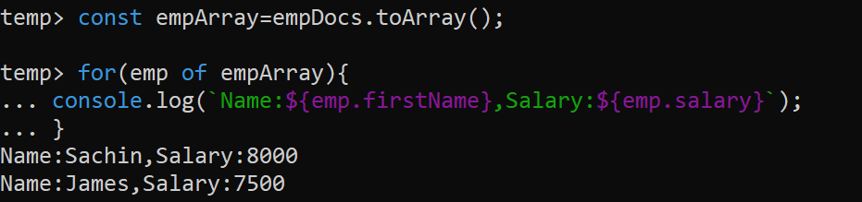
Alternate solution 2

Slide 19
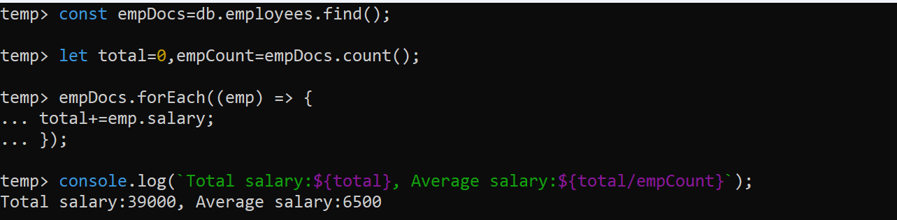
Exercise 17
Display the total salary and the average salary given by the company.

Slide 20
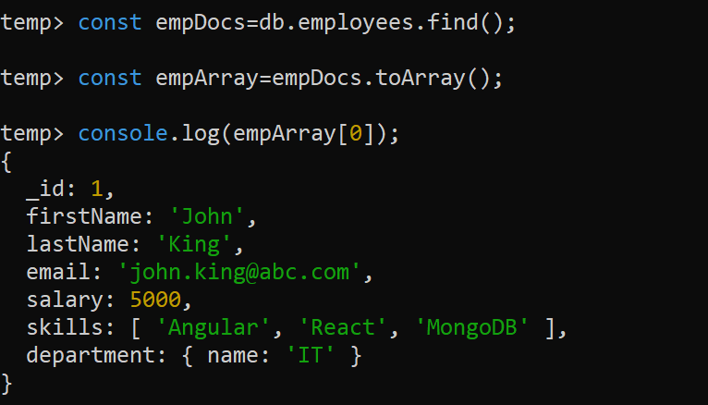
Exercise 18
Display the record of only the first employee.

Slide 21
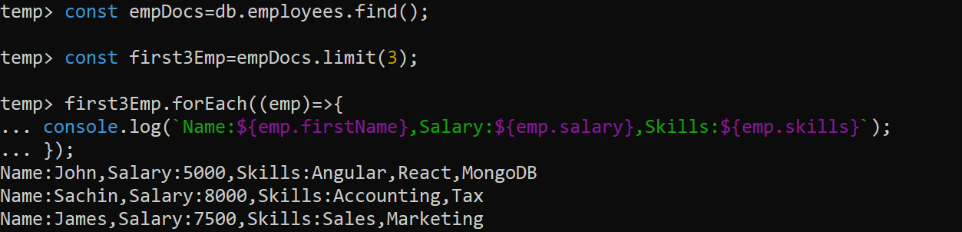
Exercise 19
Display the name, salary and skills of only the first 3 employees.

Slide 22
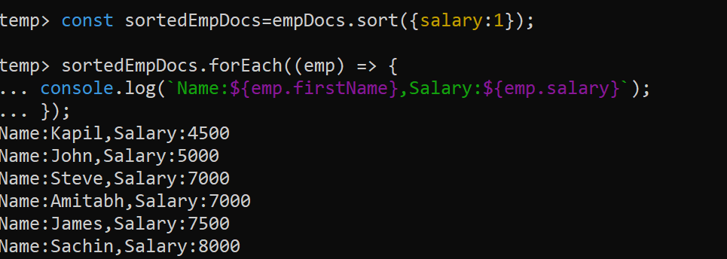
Exercise 20
Display names all the employees along with their salary in ascending order of salary.

Slide 23
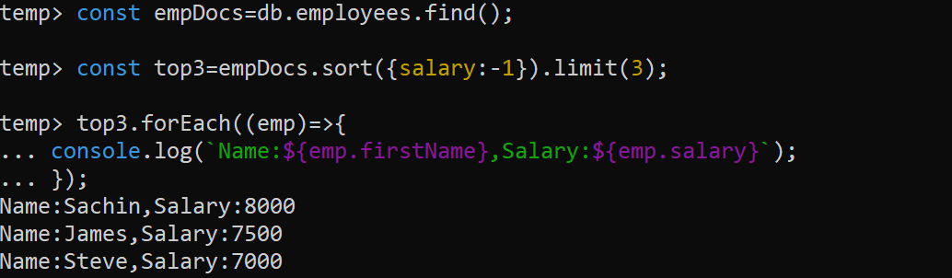
Exercise 21
Display names all the employees along with their salary of top 3 highest paid employees.

